Slide 1

Chapter 15
Connecting LANs,
Backbone Networks,
and Virtual LANs
15.<number>
Copyright © The McGraw-Hill Companies, Inc. Permission required for reproduction or display.

Slide 2
15-1 CONNECTING DEVICES
In this section, we divide connecting devices into five different categories based on the layer in which they operate in a network.
Topics discussed in this section:
Passive Hubs
Active Hubs
Bridges
Two-Layer Switches
Routers
Three-Layer Switches
Gateways
15.<number>

Slide 3

Figure 15.1 Five categories of connecting devices
15.<number>

Slide 4

Figure 15.2 A repeater connecting two segments of a LAN
A repeater connects segments of a LAN.
A repeater forwards every frame – there is no filtering.
A repeater is a regenerator, not an amplifier.
15.<number>

Slide 5

Figure 15.3 Function of a repeater
15.<number>

Slide 6

Figure 15.4 A hierarchy of hubs
A hub is a multi-port repeater, used in star-wired LANs (Ethernet).
Because of the amount of traffic and collisions, hubs can only be used in small network configurations.
15.<number>

Slide 7

Note
A bridge has a table used in
filtering decisions.
15.<number>

Slide 8

Figure 15.5 A bridge connecting two LANs
15.<number>

Slide 9
Note
A bridge does not change the physical (MAC) addresses in a frame.
15.<number>

Slide 10
Transparent Bridge
A transparent bridge is a bridge in which the stations are completely unaware of the bridge's existence.
If a bridge is added or deleted from the system, reconfiguration of the stations is unnecessary.
According to the IEEE 802.1 d specification, a system equipped with transparent bridges must meet three criteria:
  Frames must be forwarded from one station to another.
  The forwarding table is automatically made by learning frame movements in the network.
  Loops in the system must be prevented.

Slide 11

Figure 15.6 A learning bridge and the process of learning
15.<number>

Slide 12
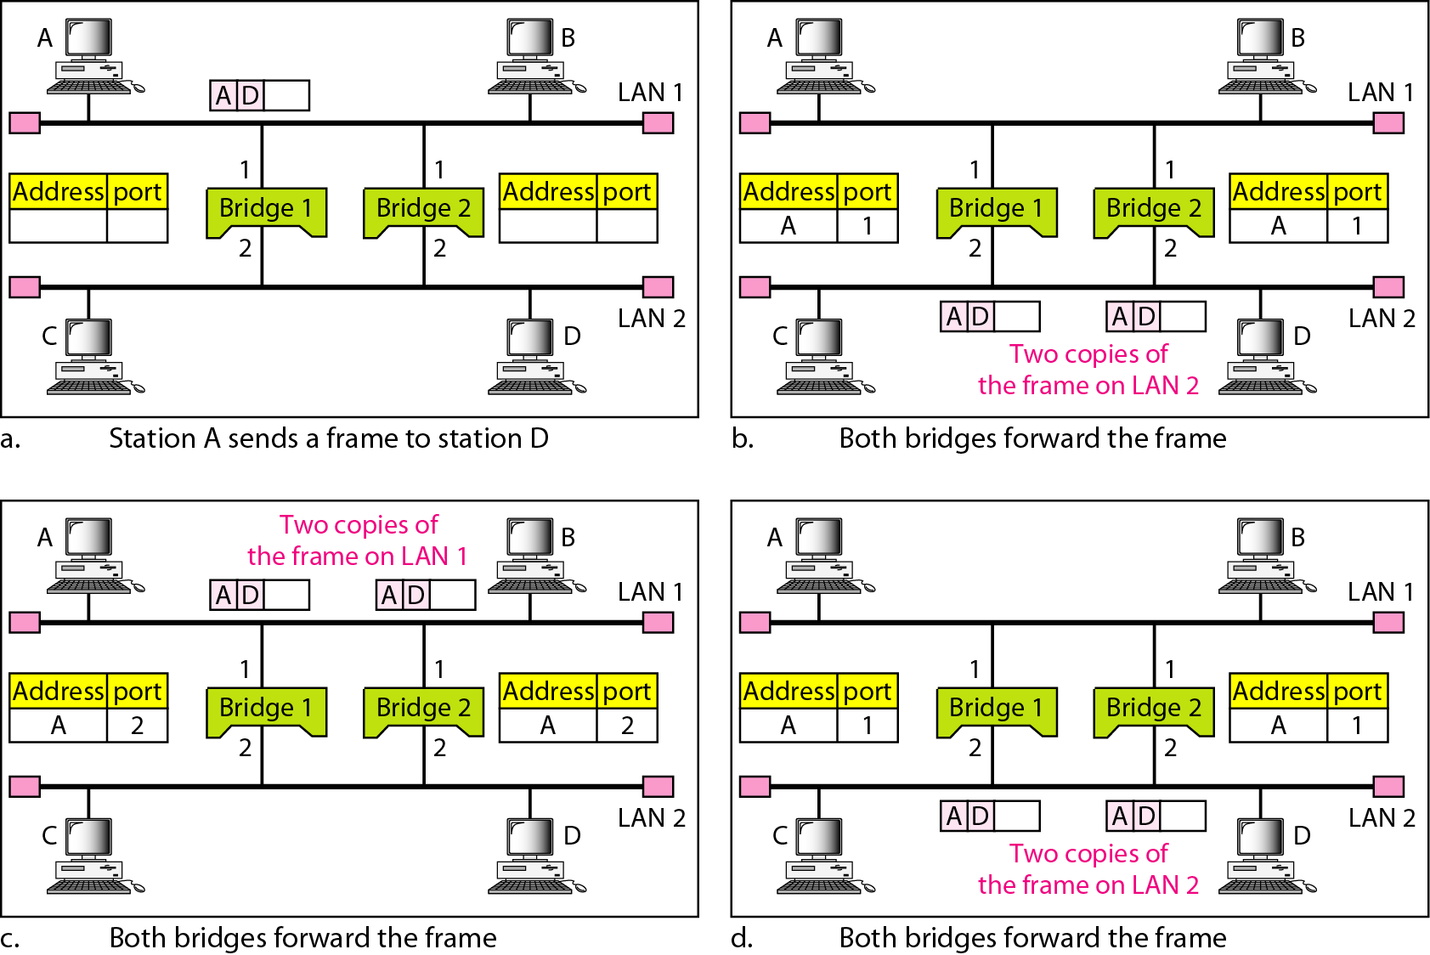
Figure 15.7 Loop problem in a learning bridge
15.<number>

Slide 13
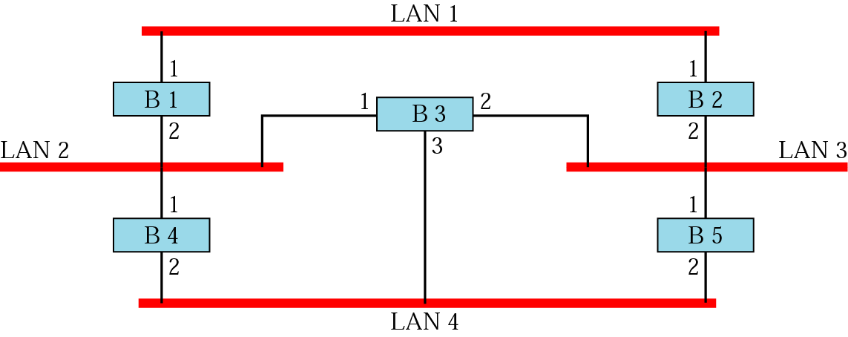
Prior to spanning tree application
What happens if you have a loop of bridges/switches in your LAN?
15.<number>

Slide 14
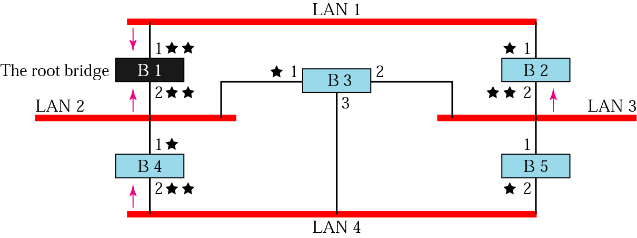
Applying spanning tree
Step 1: Every bridge has an ID. Select the bridge with smallest ID.
This is the root bridge.
Step 2: Mark one port of each bridge (except root bridge) as the
root port. Root port is the port with least-cost path from the
bridge to the root bridge (marked with 1 star).
Step 3: For each LAN, choose a designated bridge. A designated
bridge has the least-cost path between the LAN and root bridge
(the arrows). Mark the corresponding port that connects the LAN to its
designated bridge the designated port (two stars).
15.<number>

Slide 15
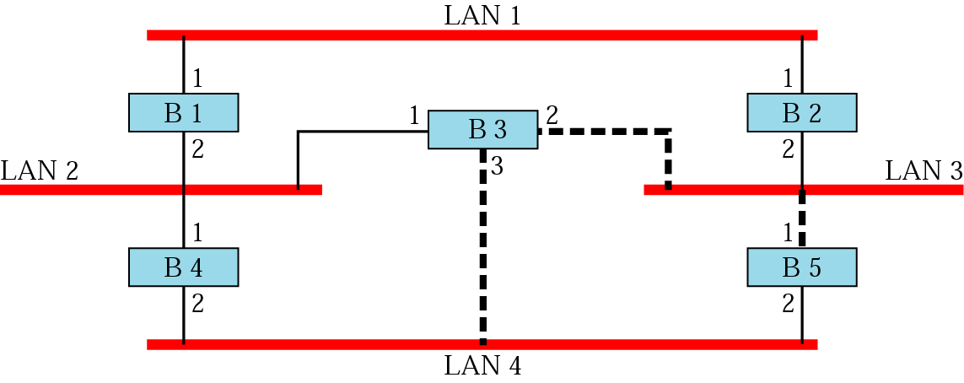
Forwarding ports and blocking ports
Step 4: Mark the root port and designated port as forwarding
ports, the others as blocking ports (every port with 1 or
2 stars keep, ports with no stars drop). Note - there is only
1 path between any two bridges.
15.<number>

Slide 16
Source Routing Bridges
Prevent loops due to redundant bridges
Transparent bridge's duties: filtering frames, forwarding, and blocking.
A sending station defines the bridges that the frame must visit and their addresses in the frame.
The frame not only contains source and destination addresses, but also the addresses of all bridges to be visited.
The source gets these bridge addresses through the exchange of special frames with the destination prior to sending the data frame.
15.<number>

Slide 17
Bridges Connecting Different LANs
Theoretically a bridge should be able to connect LANs using different protocols at the data link layer, such as an Ethernet LAN to a wireless LAN. Issues to be considered:
  Frame format: Each LAN type has its own frame format
  Maximum data size: Large data frames may be incompatible. The bridge must therefore discard any large frames
15.<number>

Slide 18
Bridges Connecting Different LANs
  Data rate: Each LAN type has its own data rate. The bridge must buffer the frame to compensate for this difference.
  Bit order: Some LAN send MSB in a byte first; others send LSB first.
  Security: Some LANs, implement security measures in DL Layer while others don’t. Bridges decrypt the messages when required.
  Multimedia support. Some LANs support multimedia and the QoS needed for this type of communication; others do not.
15.<number>

Slide 19
Two Layer Switch (Bridge)
A bridge with many ports and a design that allows better (faster) performance.
A bridge with few ports can connect a few LANs together.
A bridge with many ports may be able to allocate a unique port to each station, with each station on its own independent entity.
This means no competing traffic (no collision, as we saw in Ethernet).
15.<number>

Slide 20
Two Layer Switch (Bridge)
Filters based on the MAC address of the frame it received.
It can have a buffer to hold the frames for processing.
It can have a switching factor that forwards the frames faster.
Some new two-layer switches, called cut-through switches.
They have been designed to forward the frame as soon as they check the MAC addresses in the header of the frame.
15.<number>

Slide 21
Three Layer Switch (Router)
A router is a three-layer device that routes packets based on their logical addresses (host-to-host address or IP Address).
A router normally connects LANs and WANs in the Internet and has a routing table that is used for making decisions about the route.
The routing tables are normally dynamic and are updated using routing protocols.
Figure 15.11 shows a part of the Internet that uses routers to connect LANs and WANs.
15.<number>

Slide 22

Figure 15.11 Routers connecting independent LANs and WANs
15.<number>

Slide 23
Gateway
A gateway is normally a computer that operates in all five layers of the Internet or seven layers of OSI model.
A gateway takes an application message, reads it, and interprets it.
It can be used as a connecting device between two internetworks that use different models.
15.<number>

Slide 24
Gateway
For example, a network designed to use the OSI model can be connected to another network using the Internet model.
The gateway connecting the two systems can take a frame as it arrives from the first system, move it up to the OSI application layer, and remove the message.
Gateways can provide security.
15.<number>

Slide 25
15-2 BACKBONE NETWORKS
A backbone network allows several LANs to be connected. In a backbone network, no station is directly connected to the backbone; the stations are part of a LAN, and the backbone connects the LANs.
Topics discussed in this section:
Bus Backbone
Star Backbone
Connecting Remote LANs
15.<number>

Slide 26
Note
In a bus backbone, the topology
of the backbone is a bus.
15.<number>

Slide 27
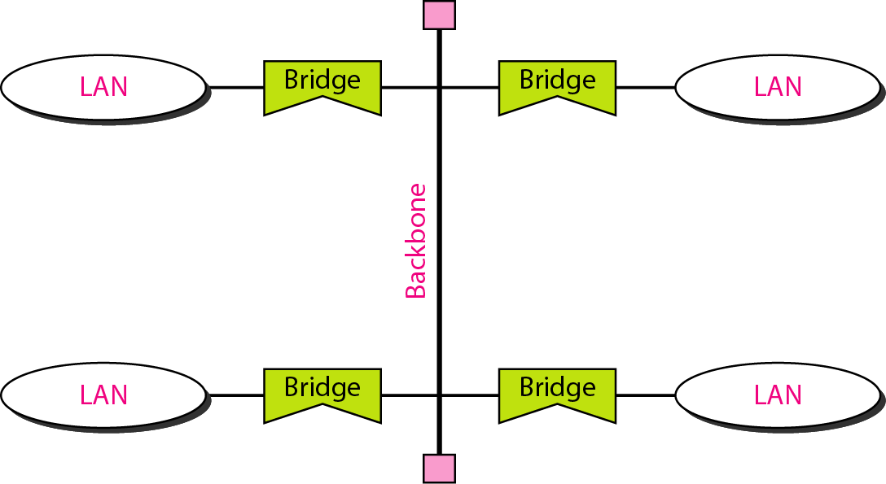
Figure 15.12 Bus backbone
15.<number>

Slide 28
Note
In a star backbone, the topology of the backbone is a star;
the backbone is just one switch.
15.<number>

Slide 29
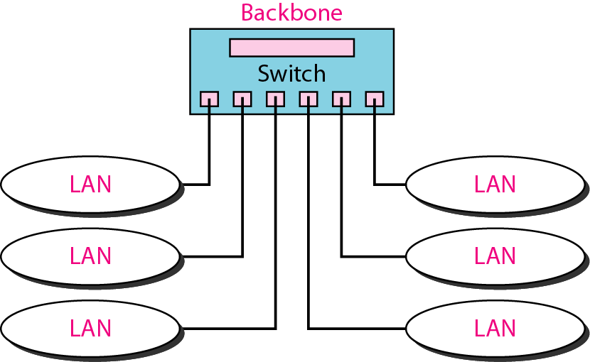
Figure 15.13 Star backbone
15.<number>

Slide 30
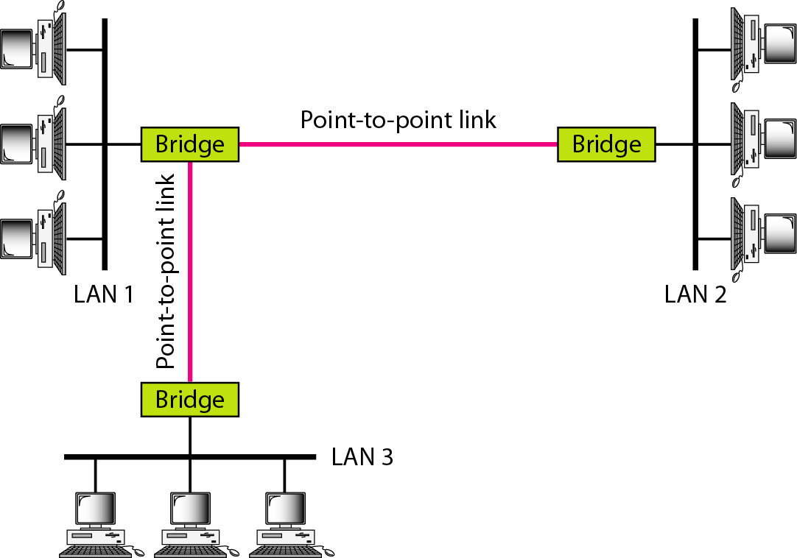
Figure 15.14 Connecting remote LANs with bridges
15.<number>

Slide 31
Note
A point-to-point link acts as a LAN in a remote backbone connected by
remote bridges.
15.<number>

Slide 32
15-3 VIRTUAL LANs
We can roughly define a virtual local area network (VLAN) as a local area network configured by software, not by physical wiring.
Topics discussed in this section:
Membership
Configuration
Communication between Switches
IEEE Standard
Advantages
15.<number>

Slide 33
VLAN
A station is considered part of a LAN if it physically belongs to that LAN.
If we need a virtual connection between two stations belonging to two different physical LANs, we can roughly define a VLAN as a LAN configured by software, not by physical wiring.
Figure 15.15 shows a switched LAN in an engineering firm in which 10 stations are grouped into three LANs that are connected by a switch.
The first four engineers work together as the first group, the next three engineers work together as the second group, and the last three engineers work together as the third group.
15.<number>

Slide 34
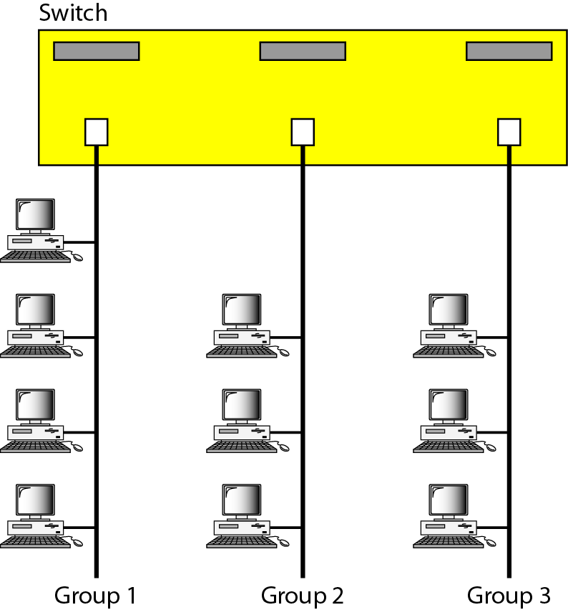
Figure 15.15 A switch connecting three LANs
15.<number>

Slide 35
VLAN
What would happen if the administrators needed to move two engineers from the first group to the third group, to speed up the project being done by the third group?
The LAN configuration would need to be changed.
The network technician must rewire.
The problem is repeated if, in another week, the two engineers move back to their previous group.
In a switched LAN, changes in the work group mean physical changes in the network configuration.
15.<number>

Slide 36
VLAN
Figure 15.16 shows the same switched LAN divided into VLANs.
VLAN technology divides a LAN into logical, instead of physical, segments.
A LAN can be divided into several logical LANs called VLANs.
Each VLAN is a work group in the organization.
If a person moves from one group to another, there is no need to change the physical configuration.
15.<number>

Slide 37

Figure 15.16 A switch using VLAN software
15.<number>

Slide 38
VLAN
Group membership in VLANs defined by software, not hardware.
Any station can be logically moved to another VLAN.
All members belonging to a VLAN can receive broadcast messages sent to that particular VLAN.
VLAN allows the grouping of stations connected to different switches in a VLAN.
Figure 15.17 shows a backbone LAN with two switches and three VLANs.
Stations from switches A and B belong to each VLAN.
15.<number>

Slide 39

Figure 15.17 Two switches in a backbone using VLAN software
15.<number>

Slide 40
Note
VLANs create broadcast domains.
15.<number>

Slide 41
VLAN Membership
Port Numbers:
  Some VLAN vendors use switch port numbers as a membership characteristic. For example, the administrator can define that stations connecting to ports 1, 2, 3, and 7 belong to VLAN 1; stations connecting to ports 4, 10, and 12 belong to VLAN 2; and so on.
MAC Addresses:
  Some VLAN vendors use the 48-bit MAC address as a membership characteristic. For example, the administrator can stipulate that stations having MAC addresses E21342A12334 and F2A123BCD341belong to VLAN 1.
15.<number>

Slide 42
VLAN Membership
IP Addresses:
  Some VLAN vendors use the 32-bit IP address (see Chapter 19) as a membership characteristic. For example, the administrator can stipulate that stations having IP addresses 181.34.23.67, 181.34.23.72, 181.34.23.98, and 181.34.23.112 belong to VLAN 1.
Multicast IP Addresses:
  Some VLAN vendors use the multicast IP address as a membership characteristic. Multicasting at the IP layer is now translated to multicasting at the data link layer.
Combination
  Recently, the software available from some vendors allows all these characteristics to be combined. The administrator can choose one or more characteristics when installing the software. In addition, the software can be reconfigured to change the settings.
15.<number>

Slide 43
How are the stations grouped into different VLANs?
Manual
  Network administrator uses the VLAN software to manually assign the stations into different VLANs at setup.
  Migration from one VLAN to another is also done manually.
  This is not a physical configuration; it is a logical configuration.
  The term manually means that the administrator types the port numbers, the IP addresses, or other characteristics, using the VLAN software.
Semiautomatic
Automatic
15.<number>

Slide 44
How are the stations grouped into different VLANs?
Manual
Semiautomatic:
  A semiautomatic configuration is somewhere between a manual configuration and an automatic configuration.
  Usually, the initializing is done manually, with migrations done automatically.
Automatic:
  The stations are automatically connected or disconnected from a VLAN using criteria defined by the administrator.
  For example, the administrator can define the project number as the criterion for being a member of a group.
  When a user changes the project, he or she automatically migrates to a new VLAN.
15.<number>

Slide 45
Communication Between Switches
In a multi-switched backbone, each switch must know not only which station belongs to which VLAN, but also the membership of stations connected to other switches.
For example, in Figure 15.17, switch A must know the membership status of stations connected to switch B, and switch B must know the same about switch A.
Three methods have been devised for this purpose:
  table maintenance,
  frame tagging, and
  time-division multiplexing.
15.<number>

Slide 46
Figure 15.17 Two switches in a backbone using VLAN software
15.<number>

Slide 47
Communication Between Switches
Table Maintenance
  When a station sends a broadcast frame to its group members, the switch creates an entry in a table and records station membership.
  The switches send their tables to one another periodically for updating.
Frame Tagging
  When a frame is traveling between switches, an extra header is added to the MAC frame to define the destination VLAN.
  The frame tag is used by the receiving switches to determine the VLANs to be receiving the broadcast message.
15.<number>

Slide 48
Communication Between Switches
Time-Division Multiplexing (TDM)
  The connection (trunk) between switches is divided into timeshared channels.
  For example, if the total number of VLANs in a backbone is five, each trunk is divided into five channels.
  The traffic destined for VLAN 1 travels in channel, the traffic destined for VLAN 2 travels in channel 2, and so on.
  The receiving switch determines the destination VLAN by checking the channel from which the frame arrived.
15.<number>

Slide 49
VLAN: Advantages
Cost and Time Reduction
  VLANs can reduce the migration cost of stations going from one group to another.
  Physical reconfiguration takes time and is costly.
  Instead of physically moving one station to another segment or even to another switch, it is much easier and quicker to move it by using software.
15.<number>

Slide 50
VLAN: Advantages
Creating Virtual Work Groups
  VLANs can be used to create virtual work groups.
  For example, in a campus environment, professors working on the same project can send broadcast messages to one another without the necessity of belonging to the same department.
  This can reduce traffic if the multicasting capability of IP was previously used.
15.<number>

Slide 51
VLAN: Advantages
Security
  VLANs provide an extra measure of security.
  People belonging to the same group can send broadcast messages with the guaranteed assurance that users in other groups will not receive these messages.
15.<number>

